Slide 1

Emotional Intelligence

Slide 2
Emotional Intelligence
Emotional intelligence is the ability to understand and manage your own emotions, as well as recognize and influence the emotions of those around you.
Emotional intelligence (EI or EQ for "emotional quotient") is the ability to perceive, interpret, demonstrate, control, evaluate, and use emotions to communicate with and relate to others effectively and constructively.
It is to understand self and others and act and react accordingly.
Emotional intelligence is the ability to understand, make good judgments and quick decisions , connection, and influence.
High emotional intelligence helps to enhance in job, increases job satisfaction by improving and increasing organization productivity.
It is a skill which is learnable.

Slide 3
Self
Others
Self Awareness Meta cognitive Awareness Knowing about self, confidence, strength, weaknesses, taking risk Knowing your emotions: What are the triggers , being fearful, situations causing anger, internal insecurity, Be self aware- breathing, knowing emotions, situations causing the adversity. | Social Awareness Empathy Organizational awareness Understanding dynamics of Relations
Self Management Ability to regularize our emotions Channelize the negative emotion in positive manner Self Motivation Bouncing back ( inner vision, inner voice, inner touch, self affirmations) Regulate emotions: Be aware of breathing pattern, physical, and present mindful awareness | Relationship Management Managing conflicts Helping others to grow Team work Communication ( Filling the gap, finding the gap, bridging the gap)
AWARENESS
Management

Slide 4
Perception

Slide 5
Perception
Perception is the organization, identification, and interpretation of sensory information in order to represent and understand the presented information or environment.
A perceptual error is the inability to judge humans, things or situations fairly and accurately. Examples could include such things as bias, prejudice, stereotyping, which have always caused human beings to err in different aspects of their lives.
https://youtu.be/vJG698U2Mvo

Slide 6
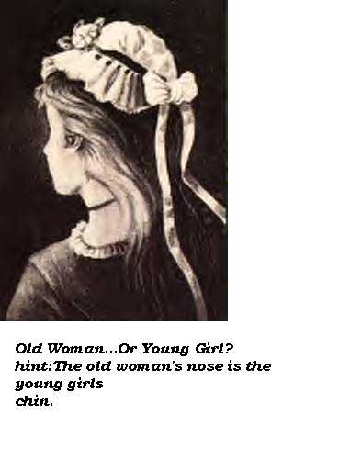

Slide 7
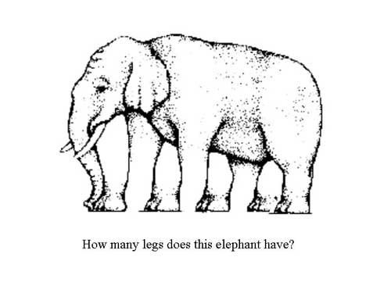

Slide 8

Figure-Ground Illustrations
Notes:
The material for this illustration is found on page 35.

Slide 9
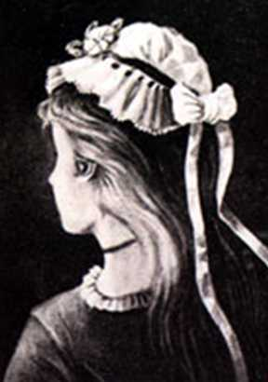


Slide 10
Perception
What Is Perception?
A process by which individuals organize and interpret their sensory impressions in order to give meaning to their environment.
Why Is it Important?
Because people’s behaviour is based on their perception of what reality is, not on reality itself.
The world as it is perceived is the world that is behaviourally important.
Notes:
This material is found on pages 34.
Perception is a process by which individuals organize and interpret their sensory impressions in order to give meaning to their environment. What one perceives can be substantially different from objective reality. Understanding perception is important because people's behaviour is based on their perception of what reality is, not reality itself.

Slide 11
Factors Influencing Perception
The Perceiver
The Target
The Situation
Notes:
This material is found on pages 35-37.
A number of factors operate to shape and sometimes distort perception.
the Perceiver who is affected by personal characteristics such as attitudes, motives, interests, past experience, and expectations.
the Target who is affected by "what we see," attractive or unattractive individuals, motion, sounds, size, and other attributes of a target shape the way we see it
the Situation which is the context in which we see objects or events. The situation is important as elements in the surrounding environment influence our perceptions.

Slide 12
Factors that Influence Perception
The Situation
•
Time
•
Work setting
The Perceiver
•
Social setting
•
Attitudes
•
Motives
Perception
•
Interests
•
Experience
•
Expectations
The Target
•
Novelty
•
Motion
•
Sounds
•
Size
•
Background
•
Proximity
Notes:
The material for this illustration is found on page 36.

Slide 13
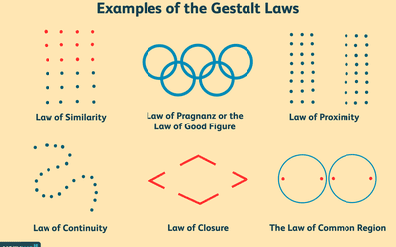
Types of Perception

Slide 14
Factors Affecting Judgment
Attribution Theory
Perceptual Errors
Selective Perception
Halo Effect
Contrast Effects
Projection
Stereotyping
Notes:
This material is found on pages 37-41.

Slide 15
Attribution Theory
When individual observe behaviour, they attempt to determine whether it is internally or externally caused.
Distinctiveness
Does individual act the same way in other situations?
Consensus
Does individual act the same as others in same situation?
Consistency
Does the individual act the same way over time?
Notes:
This material is found on pages 37-38.
Attribution Theory says we judge people differently depending on what meaning we attribute to a given behaviour.
We attempt to determine whether the behaviour was internally- or externally-caused.
Externally-caused refers to the environment, while internally-caused behaviour is attributed to those events that are believed to be under the personal control of the individual.
Our determination of internally or externally caused behaviour depends on three factors:
Distinctiveness; whether an individual displays different behaviour in different situations
Consensus: If everyone who is faced with a similar situation responds in the same way, we can say the behaviour shows consensus.
Consistency. Is the person’s actions consistent over time.

Slide 16
Attribution Theory says we judge people differently depending on what meaning we attribute to a given behaviour.
We attempt to determine whether the behaviour was internally- or externally-caused.
Externally-caused refers to the environment, while internally-caused behaviour is attributed to those events that are believed to be under the personal control of the individual.
Our determination of internally or externally caused behaviour depends on three factors:
Distinctiveness; whether an individual displays different behaviour in different situations
Consensus: If everyone who is faced with a similar situation responds in the same way, we can say the behaviour shows consensus.
Consistency. Is the person’s actions consistent over time.

Slide 17
Attribution Theory
Fundamental Attribution Error
The tendency to underestimate the influence of external factors and overestimate the influence of internal factors when making judgments about the behaviour of others.
Self-Serving Bias
The tendency for individuals to attribute their own successes to internal factors while putting the blame for failures on external factors.
Notes:
This material is found on pages 39.

Slide 18
Perceptual Errors
Selective Perception
People selectively interpret what they see based on their interests, background, experience, and attitudes
Halo Effect
Drawing a general impression about an individual based on a single characteristic
Contrast Effects
A person’s evaluation is affected by comparisons with other individuals recently encountered
Notes:
This material is found on pages 39-40.

Slide 19
Types of perceptual errors in workplace
1.Selective Perception-People generally interpret according to their basis of interests, idea and backgrounds. It is the tendency not to notice and forget the stimuli that cause emotional discomfort. For example we might think that fresher graduates with above 80 % marks will exceptionally do well in technical interviews of respective subjects
2.Halo Effect-We misjudge people by concentrating on one single behavior or trait. It has deep impact and give inaccurate result most of the time. For example we always have an impression of a lazy person can never be punctual in any occasion.
3.Stereotypes-We always have a tendency to classify people to a general groups /categories in order to simplify the matter. For example-Women are always good homemakers and can do well in work life balance
4.Contrast Effect-We again sometimes judge people in comparison to others . This example generally found in sports, academics and performance review
5.Projection-This is very common among Perceptual errors. Projection of one’s own attitude, personality or behavior into some other person. For example- To all honest people, everybody is honest.
6.Impression-We all know the term “first impression is the last impression” and we apply that too .For example-During the time of hiring, thought like this “The most decent and modest person in the interview can do very well in every roles and responsibilities ” always arise.

Slide 20
Errors in perception can be overcome by
Taking more time and avoiding instant or `snap’ judgements about others.
Collecting and consciously using more information about other people.
Developing self-awareness and an understanding of how our personal biases are preferences affect our perceptions and judgements of other people.
Checking our attributions – particularly the links we make between aspects of personality and appearance on the one hand and behaviour on the other.

Slide 21
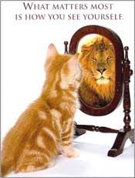
Self Awareness , Self Management, Self Affirmation, Social Awareness, Relationship Management
https://www.youtube.com/watch?v=qR3rK0kZFkg

Slide 22
Signs of Emotional Intelligence
An ability to identify and describe what people are feeling
An awareness of personal strengths and limitations
Self-confidence and self-acceptance
The ability to let go of mistakes
An ability to accept and embrace change
A strong sense of curiosity, particularly about other people
Feelings of empathy and concern for others
Showing sensitivity to the feelings of other people
Accepting responsibility for mistakes
The ability to manage emotions in difficult situations

Slide 23
Components of Emotional Intelligence
Thinking before reacting.
Greater self-awareness.
Empathy towards others.
Motivation.
Social skills.
Self management

Slide 24
How to Use Emotional Intelligence
Being able to accept criticism and responsibility
Being able to move on after making a mistake
Being able to say no when you need to
Being able to share your feelings with others
Being able to solve problems in ways that work for everyone
Having empathy for other people
Having great listening skills
Knowing why you do the things you do
Not being judgmental of others

Slide 25
Perception
What Is Perception?
A process by which individuals organize and interpret their sensory impressions in order to give meaning to their environment.
Why Is it Important?
Because people’s behaviour is based on their perception of what reality is, not on reality itself.
The world as it is perceived is the world that is behaviourally important.
Notes:
This material is found on pages 34.
Perception is a process by which individuals organize and interpret their sensory impressions in order to give meaning to their environment. What one perceives can be substantially different from objective reality. Understanding perception is important because people's behaviour is based on their perception of what reality is, not reality itself.

Slide 26
Factors Influencing Perception
The Perceiver
The Target
The Situation
Notes:
This material is found on pages 35-37.
A number of factors operate to shape and sometimes distort perception.
the Perceiver who is affected by personal characteristics such as attitudes, motives, interests, past experience, and expectations.
the Target who is affected by "what we see," attractive or unattractive individuals, motion, sounds, size, and other attributes of a target shape the way we see it
the Situation which is the context in which we see objects or events. The situation is important as elements in the surrounding environment influence our perceptions.

Slide 27
EMOTIONAL INTELLIGENCE SELF-ASSESSMENT

Slide 28
Role Play
Team Building
Conflict Management
Employee Behavior
Dealing with clients
Story telling
Time Management
Problem solving
Motivation
Emotions

Slide 29
THANK YOU

